Slide 1

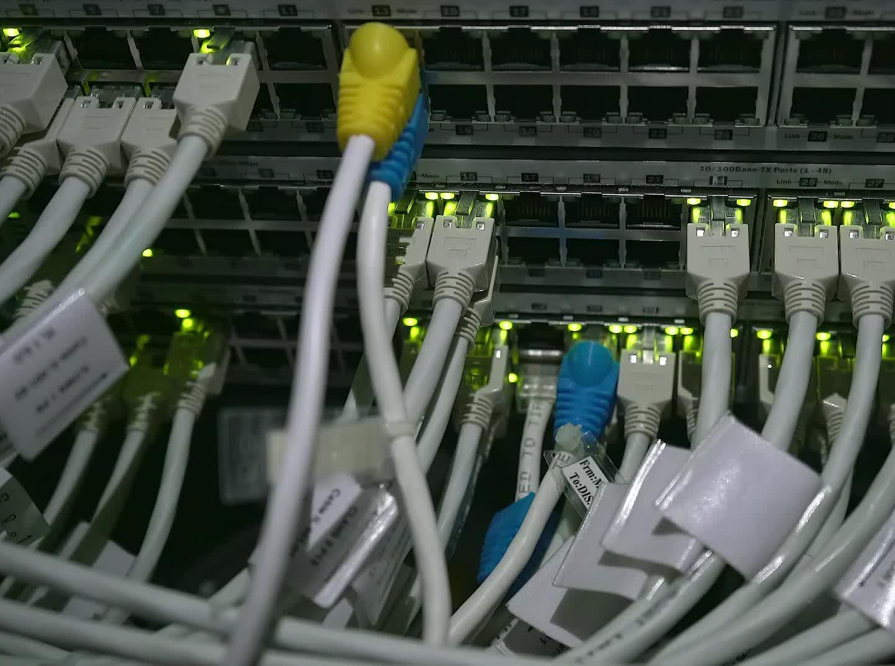


CS621 Parallel and Distributed Computing
Dr. Muhammad Anwaar Saeed
Dr. Said Nabi
Ms. Hina Ishaq

Slide 2
CS621 Parallel and Distributed Computing
What is Computing?

Slide 3


Objectives
Introduction of Computing.
History of Computing.

Slide 4
What is Computing
“Computing is the process to complete a given goal-oriented task by using computer technology.”

Slide 5




What is Computing Cont.…
Computing may include the design and development of software and hardware systems for broad range of purposes.
Used for structuring, processing and managing any kind of information - to aid in the pursuit of scientific studies and making intelligent systems.

Slide 6
History of Computing
Batch Era
Time Sharing Era
Desktop Era
Network Era

Slide 7
History of Computing Cont..
Batch Era: Execution of series of programs on a computer without manual intervention.
Time Sharing: Sharing of computing resource among many users by means of multiprogramming and multi-tasking.
Desktop Era: A personal computer provides computing power to one user.
Network Era: Systems with shared memory and distributed memory.

Slide 8
CS621 Parallel and Distributed Computing
Serial Vs. Parallel Computing

Slide 9



Objectives
Serial Computing.
Parallel Computing.
Difference between serial and parallel computing

Slide 10
Serial Computing
“Serial computing is a type of processing in which one task is completed at a time and all the tasks are executed by the processor in a sequence.”

Slide 11
Parallel Computing
“Parallel computing is a type of computing architecture in which several processors simultaneously execute multiple, smaller calculations broken down from an overall larger, complex problem.”

Slide 12
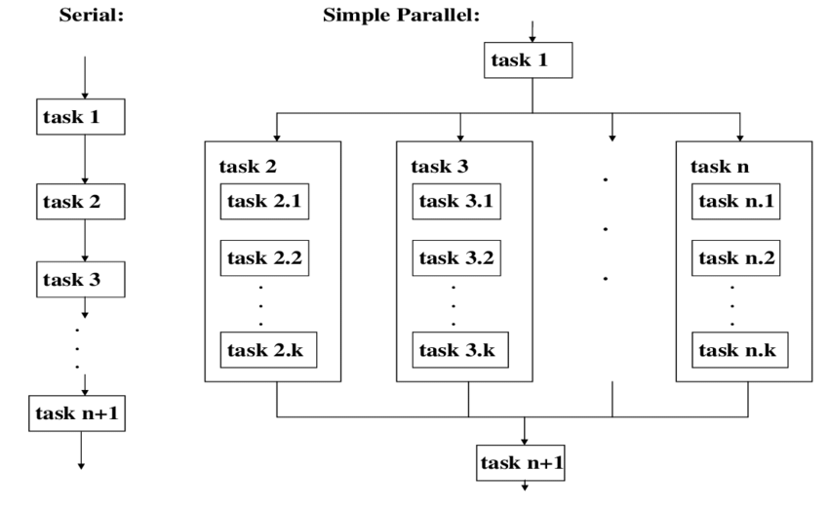
Serial vs parallel Computing Cont..

Slide 13
Difference between Serial and parallel Computing
Serial Computing
Parallel Computing
Are uniprocessor systems.
Are multiprocessor systems.
Can execute one instruction at a
Can execute multiple instructions
time.
at a time.
Speed is limited.
No limitation on speed.
Lower performance.
Higher performance.
Examples: EDVAC, BINAC, and LGP-30.
Example: Window 7, 8 and 10.

Slide 14
CS621 Parallel and Distributed Computing
Introduction to Parallel Computing

Slide 15
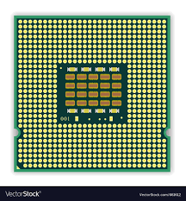
Objectives
Parallel Computing
Multi-Processer
Multi-Core

Slide 16
Introduction to Parallel Computing
“Parallel Computing is the simultaneous execution of the same task (split up and adapted) on multiple processors in order to obtain faster results.”

Slide 17
Introduction to Parallel Computing Cont.…
It is a kind of computing architecture where the large problems break into independent, smaller, usually similar parts that can be processed in one go. It is done by multiple CPUs communicating via shared memory, which combines results upon completion. It helps in performing large computations as it divides the large problem between more than one processor.
HPC: High Performance/Productivity Computing
Technical Computing
Cluster computing

Slide 18


Introduction to Parallel Computing Cont.…
The term parallel computing architecture sometimes used for a computer with more than one processor available for processing.
The recent multicore processor (chips with more than one processor core) are some commercial examples which bring parallel computing to the desktop.

Slide 19
Introduction to Parallel Computing Cont.…
Multi-processor
More than one CPU works together to carry out computer instructions or programs.
Multi-core
Is a microprocessor on a single integrated circuit with two or more separate processing units, called cores, each of which reads and executes program instructions.

Slide 20
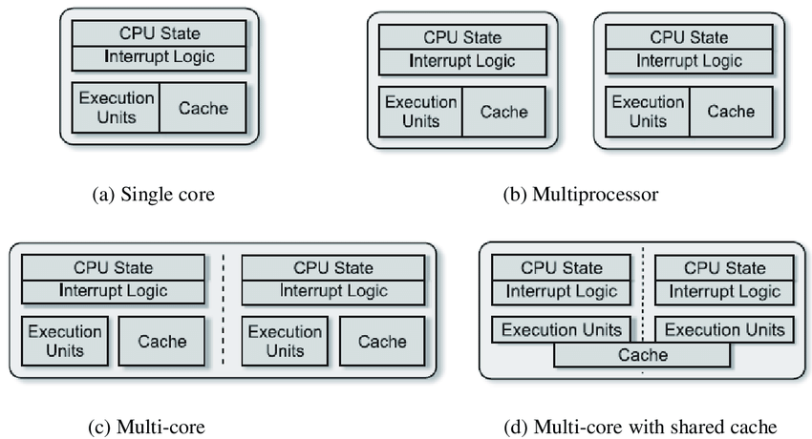
Introduction to Parallel Computing Cont…

Slide 21
CS621 Parallel and Distributed Computing
Principles of Parallel Computing

Slide 22

Objectives
Principles of Parallel Computing.

Slide 23
Principles of Parallel Computing
Finding enough parallelism
Performance modeling
Scale
Coordination and Synchronization
Locality
Load balance

Slide 24
Principles of Parallel Computing Cont…
Finding Enough Parallelism
Conventional architectures coarsely comprise of a processor, memory system, and the data-path. Each of these components' present significant performance bottlenecks. Parallelism addresses each of these components in significant ways.
Scale
Parallelism overhead includes cost of starting a head, accessing data, communicating shared data, synchronization and extra computation. Algorithms needs sufficiently large units of work to run fast in parallel.
Locality
Parallel processors collectively have large and fast cache. The memory addresses are distributed across the processors, a processor may have faster access to memory locations mapped locally than to memory locations mapped to other processors.

Slide 25
Principles of Parallel Computing Cont.…
Load Balance
Determines the workload, divide up evenly before staring in case of static load balancing but in dynamic load balance workload changes dynamically, need to rebalance dynamically.
Coordination and Synchronization
Several kind of synchronization is needed by processes cooperating to perform computation.
Performance Modeling
More efficient programming models and tools formulated for massively parallel supercomputers.

Slide 26
CS621 Parallel and Distributed Computing
Why Use Parallel Computing?

Slide 27

Objectives
Identifying the aspects that make parallel computing more useful.

Slide 28
Why Use Parallel Computing?
Computing power
Provide concurrency
Performance
Solve large problems
Scalability

Slide 29
Why Use Parallel Computing?
Computing power
Modern consumer grade computing hardware comes equipped with multiple central processing units (CPUs) and/or graphics processing units (GPUs) that can process many sets of instructions simultaneously.
Performance
Theoretical performance steadily increased, due to the fact that performance is proportional to the product of the clock frequency and the number of cores.
Scalability
Problem can be scaled up from size to sizes that were out of reach with a serial application. The larger problem sizes are enabled by the larger amounts of main memory, disk storage, bandwidth over networks and to disk, and CPUs.

Slide 30
Why Use Parallel Computing Cont.…
Solve large problems
Solve large problems by breaking down larger problems into smaller, independent, often similar parts that can be executed simultaneously by multiple processors communicating via shared memory. Can solve large problems like Web search engines, processing millions of transaction per second, etc.
Cost
the cost of computation would reduce if we are to deploy parallel computation than sequential computation.
Provide concurrency
Parallelism leads naturally to Concurrency. For example, Several processes trying to print a file on a single printer.

